Slide 1

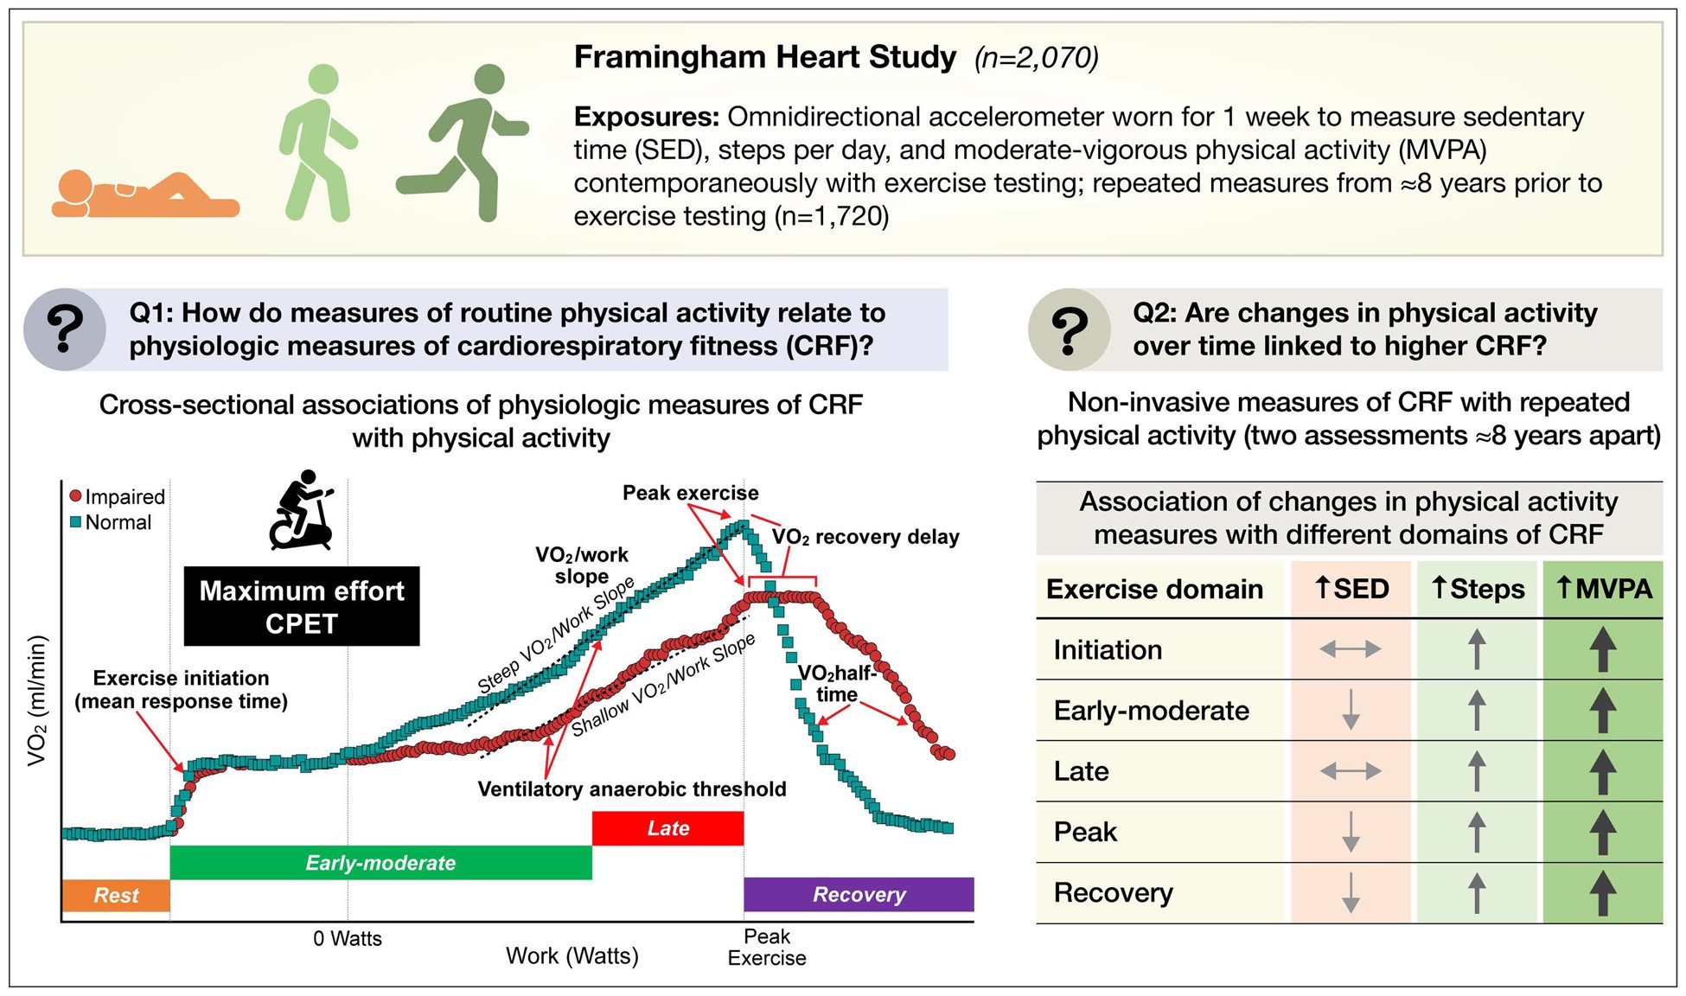

An overview of the study design is displayed. Cardiopulmonary fitness measures were associated with ...
Notes:
An overview of the study design is displayed. Cardiopulmonary fitness measures were associated with omnidirectional accelerometry data concurrent with exercise testing and from ≈8 years prior to evaluate the relations of physical activity and fitness.
Unless provided in the caption above, the following copyright applies to the content of this slide: Published on behalf of the European Society of Cardiology. All rights reserved. © The Author(s) 2021. For permissions, please email: journals.permissions@oup.com.This article is published and distributed under the terms of the Oxford University Press, Standard Journals Publication Model (https://academic.oup.com/journals/pages/open_access/funder_policies/chorus/standard_publication_model)

